Slide 1



Demographic policy measures

Slide 2




Republic of Croatia
Situated on western Balkan
Population: 4,087,843
Capital: Zagreb
Population of Zagreb: 804,507
Administrative organisation: 20 counties and City of Zagreb
Economy: tourism dominates (accounts for up to 20% of Croatian GDP)
Because of interesting geostrategic position, Croatia was always interesting to other nations

Slide 3


Demography of Croatia
Population density in 2018 - 72,9 inhabitants per square kilometer (one of the more sparsely populated European countries)
The overall life expectancy was 76.3 years in 2018
The total fertility rate of 1.41 children per mother - one of the lowest in the world
Since 1991, Croatia's death rate has continuously exceeded its birth rate
One of the oldest populations in the world - average age of 43.3 years
Since the late 1990’s - positive net migration into Croatia
The natural growth rate of the population is currently negative

Slide 4

City of Zagreb
cultural, scientific, economic, political and administrative center of the Republic of Croatia with seat of Parliament, President and Government of the Republic of Croatia
The City of Zagreb reserves powers and duties as both city and county
City Administration bodies: the City Assembly (representative body) and the Mayor (executive body)

Slide 5
City of Zagreb
Economy - most important branches of industry: production of electric machines and devices, chemical, pharmaceutical, textile, food and drink processing. Zagreb is important international trade and business center, and transports crossroad of Central and East Europe
University of Zagreb - oldest in Croatia and one of the oldest in Europe (founded in 1669) - 28 faculties, 3 art academies, 1 expert Teacher Academy
Culture - 38 cultural institutions which include 10 city museums, owner of 7 city theaters and is in 50% owner of Croatian National Theatre, owner of Vatroslav Lisinski Concert Hall and Zagreb Philharmonic Orchestra

Slide 6

Demographic policy measures
City of Zagreb recognized importance of demographic policy measures through support measures aimed at children, youth and families
New-born essentials allowance (defined after the 2001 Census of Population, started at 2004)
financial measure
every newborn child with residence in Zagreb, under certain conditions, is granted with allowance
sum of allowance depends on the number of children in the family (for the first child 240 €, for the second child 480 € and for the third and every next child 7,200 €)

Slide 7

Demographic policy measures
Allowance for stay-at-home- parents (financial measure, started at 2016)
one of the parents, who cares for at least three children, is entitled to monetary support, if the youngest child has not started school yet
monthly monetary support in the amount of the gross earnings in the economy of the City of Zagreb (includes taxes and contributions); for 2019 monthly net sum is 566 €
only City of Zagreb in Republic of Croatia is providing such measure for its citizens under certain conditions (at least three children, parent must not be employed or in retirement, youngest child must not go to school or be enrolled in day-care)
at this moment 4,500 parents are users of this allowance

Slide 8
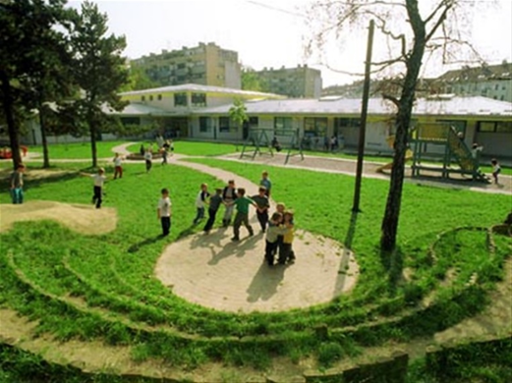
Demographic policy measures
Daycare co-financing
the City of Zagreb co-finances daycare services whether they are owned by the City or private institutions
co-financing depends on household per capita income
families with more children very often receive free daycare services
monthly economic price for one child is 253 €, max. amount for parents is 80 €
36,000 children attended daycare in 2018

Slide 9

Demographic policy measures
Extended day programme in primary schools
the City of Zagreb also provide funding for extended day programme in first three grades (children have lessons in the morning and afterwards they have lunch and tutoring time for doing homeworks with trained teachers; they stay in school from 8 till 5 pm)
co-financing depends on household per capita income
families with more children very often receive free services
over 13,000 children attended extended day programme in 2018

Slide 10

Demographic policy measures
Free textbooks (until 2019)
the City of Zagreb assured for each primary and secondary student textbooks and workbooks for free
from 2019, State took over funding of textbooks, but workbooks are still assured by the City of Zagreb
yearly, City of Zagreb allocated over 5,3 mil € for all textbooks and workbooks for primary and secondary school students

Slide 11

Demographic policy measures
Scholarship schemes – best investment in the future
the City of Zagreb award students with different kind of scholarships through public tender
6 different scholarships schemes: for excellent students of secondary schools, university and doctoral students; for students preparing for small business shortage occupations; scholarship for Roma pupils and university students; for pupils and university students from lower social status families; for pupils and university students with disabilities; for students of secondary schools that has won a medal on international competitions and for secondary school students preparing for nurses
over 300 scholarships is awarded each year for which are assured over 6,7 mil €

Slide 12

Demographic policy measures
Health policy measures aimed at children, adolescents and families
primary healthcare is available to all citizens (paediatric, dentist and family care, laboratories and diagnostics) – assured by The State
City has undertaken further measures to improve healthcare services - counselling centres (Breastfeeding Counselling Centre, Correct Positioning and Motor Functions Stimulation Counselling Centre ("baby handling"), Counselling Centre for Growth and Healthy Child Development, antenatal classes, lactation counselling centres, adolescent reproductive health counselling centres)
newest center from 2019 – Center for planning family
all counseling is free of charge, expert assistance, no waiting lines (frequent users are numerous families)

Slide 13
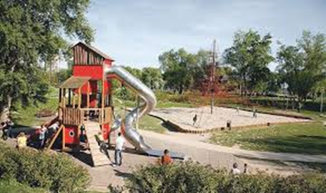
Demographic policy measures
Children and teenagers: free time and creative expression
numerous programmes and projects aimed at children and teenagers - free for participants
organized free time - most efficient prevention of problematic children's and youth behaviour
the public tender for the financing projects aimed at the prevention of child and adolescent problematic behaviour yearly foresees 220,000 €
more than 630 children's playgrounds in public areas
free membership for the services of Zagreb City Libraries to all children under 15
"Odmorko" children's programme (more than 26,000 participants yearly) - sports activities during school vacation
„Nature Kindergarten” programme for all preschool children
„Nature school programme” aimed at third and fourth grade primary school pupils

Slide 14

Demographic policy measures
Social policy measures aimed at children, youth and families - City social policy priority
poverty is hard to eradicate; intended for families facing the risk of poverty and increasing life quality of all family members, especially children
the greatest risk of poverty - children from numerous families, children from single-parent families and families with no employed family members
includes: scholarships, family packages assistance, infant formula assistance, free summer vacation for children from families of lower social status and rehabilitation-recreational vacation programme for children with developmental difficulties and for persons with disabilities, children gift packages for Easter and St. Nicholas day, allowance for persons with recognised parent caretaker status or child with developmental difficulties caretaker status, free public transportation

Slide 15

Thank you!

